Slide 1
Neck swellings
P.D/ Nazem Shams
Prof. of surgical oncology

Slide 2
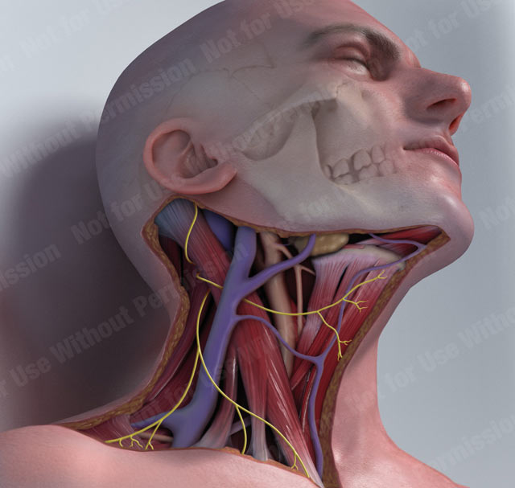
Basic Anatomy
Anterior
Triangle
Sternocleidomastoid
muscle
  Submental
  Submandibular
  muscular
      Carotid
Posterior
Triangle
Clavicle

Slide 3
Basic Anatomy

Slide 4
How do we differentiate neck swellings?
General swelling:
1- Skin: sebaceous cyst
2- S.C.: Lipoma
3- Vessels: hemangioma
4- Lymphatics: lymphangioma
5- Nerves: neurofibroma, schwannoma
6- Muscles: tumors

Slide 5
How do we differentiate neck swellings?
Swellings In The Middle Line Of The Neck
1- Submental abscess
2- Sequestration dermoid cyst: Submental or suprasternal
3- Enlarged lymph nodes: Submental, prelaryngeal or pretracheal.
- Multiple, inflammatory vs. malignancy.
4- Sub-hyoid bursitis
5- Thyroglossal cyst
6- Nodule or cysts in the isthmus of thyroid
7- Swelling in the suprasternal (Burns’s) space: (Rare)
* Cystic:
a- Usually dermoid: Aspiration differentiates it from a cold abscess.
b- Aneurysm of arch of aorta → expansile pulsation.
* Solid: Lipoma or enlarged lymph nodes

Slide 6
Swellings In The lateral side of the neck
A- Swellings In The Region Of Sternomastoid
(1) The commonest: Lymph nodes enlargement.
(2) Next common: Thyroid lobe enlargement.
(3) Rare swellings:
1. Branchial cyst.
2. Aneurysm of the carotid vessels.
3. Swellings of the sternomastoid muscle itself e.g. haematoma or tumour
4. Carotid body tumour.
5. Laryngocele.
6. Cystic hygroma
7. Plunging ranula.
8. Pneuomatocele.
9. Pharyngeal diverticulum (Zenker's diverticulum).

Slide 7
B- Swellings In The Submandibular Region
1 Gland: inflammatory, tumor, autoimmune, sialectasis, sialosis
2- L.N. Submandibular L.N.
5- Mandible Adamantinoma & Osteoma
6- Plunging ranula.
7- Ludwig’s angina.

Slide 8
C- Swellings In The Posterior Triangle
(1) Lymph node enlargement: The commonest.
(2) Cystic hygroma.
(3) Prominent cervical rib.
(4) Aneurysm of subclavian artery.
(5) Pharyngeal diverticulum (Zenker's diverticulum)
(6) Pneumatocele.

Slide 9
PULSATING NECK SWELLINGS
A- In communication with lumen of artery:
1. Carotid aneurysm
2. Subclavian aneurysm
3. A-V fistula.
B- On line of artery (Transmitted pulsation):
1. Carotid body tumor
2. Enlarged cervical lymph node
C- Highly vascular swelling:
1. Goitre
2. Sarcoma
3. Cercoid aneurysm.

Slide 10
PAINFUL NECK SWELLINGS
A- Thyroid causes:
1- Acute thyroiditis
2- Subacute thyroditis.
3- Painful Hashimoto's thyroiditis.
4- Acute hyroid cyst.
5- Rapidly enlarging thyroid carcinoma.
6- Radiation thyroiditis
B- Non thyroid causes:
1- Infected thyroglossal cyst
2- Infected branchial cyst.
3- Infected cystic hygroma
4- Cervical adenitis.
5- Globus hustericus (no mass palpable).

Slide 11
GOITER Gutter = Throat
(1) Cretenoid Goiter (Hypothyroidism)
(2)Simple Goiter (Euothyroidism):
a) Diffuse hyperplastic goiter: Physiological, colloid.
b) Simple Nodular goiter: STN, MNG.
(3) Toxic Goitre (Hyperthyroidism): 1ry (Grave’s), 2ry (Plummer’s), Toxic Nodule.
(4)Inflammatory goiter (Thyroiditis):Acute bacterial, Subacute (De Quervains), Auto immune (Hashimoto’s), Riedl’s, postpartum, Chronic as tuberculosis, and syphilis.
(5) Neoplastic: Benign, Malignant: either 1ry or 2ry.
(6) Miscellaneous: Amyloidosis.

Slide 12
definition
“Any enlargement of the thyroid gland. This can be diffuse or nodular and can be described with respect to its aetiology i.e. physiological, inflammatory or toxic”

Slide 13
Grave's disease
Autoimmune disorder
Immunoglobulins stimulate TSH receptors
Goitre
Heat intolerance
Increased appetite with weight loss
Eye signs
Other manifestations of Hyperthyroidism
Diffuse symmetrical soft goitre with audible bruit and palpable thrill.

Slide 14
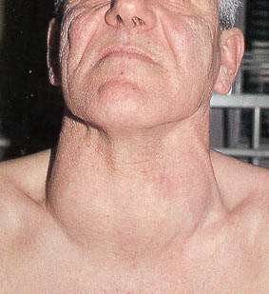

Slide 15
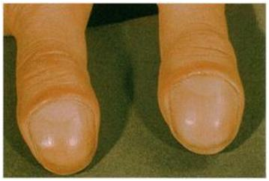
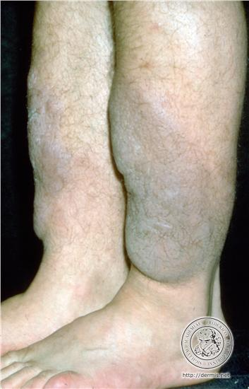
HANDS
  Palmar erythema, thyroid acropachy
WRIST
  AF, large volume pulse
OUTSTRETCHED ARMS
  Fine tremor
NEURO
  Proximal myopathy
LEGS
  Pre-tibial myxoedema

Slide 16


Slide 17
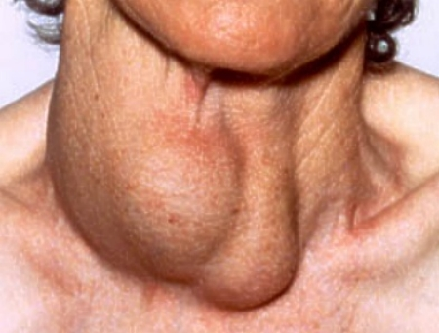
Multinodular Goitre
Simple or toxic.
Asymmetrical enlarged gland.
Variable sized nodules.
Complications:
Cyst formation
Compression
Carcinoma formation
Calcification
RSE
2ry thyrotoxicosis

Slide 18
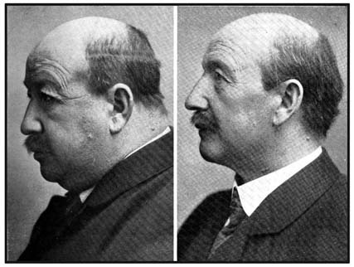
Hypothyroidism
Usually no goitre except in case of Hashimoto's
  Autoimmune condition typically affecting ♀s
  Hyperthyroidism → Hypothyroidism
  Firm goitre, small-medium sized
Rx with Thyroxine replacement

Slide 19
Thyroid Cancers
MALIGNANT
1) Papillary - 70% M:F= 1:3
2) Follicular - 15% M:F= 1:3
3) Medullary - 5-10%
4) Anaplastic - Rare R.I.P.
Plus: Lymphoma, teratoma, squamous and 2er
BENIGN
Follicular adenoma, no papillary adenoma

Slide 20
Groups of cervical Nodes
Submental
Submandibular
Parotid / tonsilar
Preauricular
Postauricular
Occipital
Anterior cervical superficial and deep
Supraclavicular
Posterior cervical

Slide 21
Description
Site
  Localised or generalised, 1 or 2+
Size
  Greater then 1 cm
Tenderness
  Suggests acute inflammation or infection
Consistency
  Soft may be normal, hard suggests carcinoma, rubbery suggests lymphoma
Fixation
  Fixation to underlying structures more suggestive of carcinoma

Slide 22
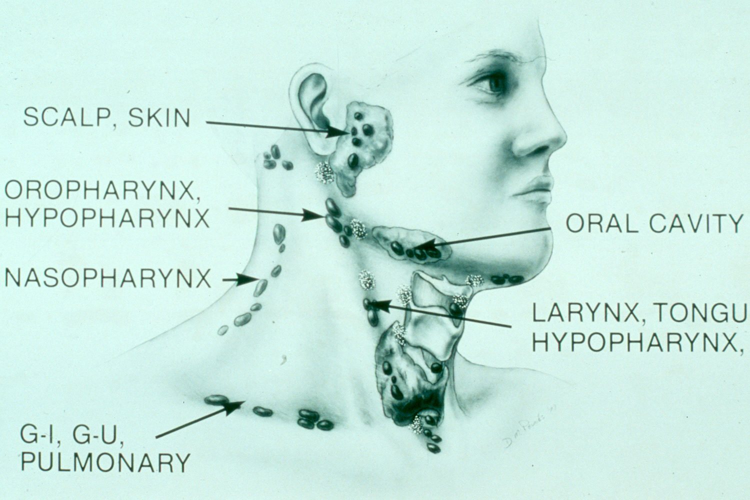
Metastasis Location according to Various Primary Lesions

Slide 23
Cervical Lymph Node exam
Would also require
  Examination of axillary, inguinal and epitrochlear nodes
    For generalised lymphadenopathy
  Full ENT examination
  Abdominal examination
    Splenomegaly, hepatomegaly para aortic nodes and masses

Slide 24
Granulomatous lymphadenitis
Infection develops over weeks to months.
Minimal systemic complaints or findings.
Common etiologies:
  TB, atypical TB, cat-scratch fever, actinomycosis, sarcoidosis
Firm, relatively fixed node with injection of skin.

Slide 25
Granulomatous lymphadenitis
Typical M. tuberculosis
  more common in adults
  Posterior triangle nodes
  Usually responds to anti-TB medications
  May require excisional biopsy for further workup

Slide 26
Granulomatous lymphadenitis
Atypical M. tuberculosis
  Pediatric age groups
  Anterior triangle nodes
  Brawny skin, induration and pain
  Usually responds to complete surgical excision or curettage

Slide 27
Granulomatous lymphadenitis
Cat-scratch fever (Bartonella)
  Pediatric group
  Preauricular and submandibular nodes
  Spontaneous resolution with or without antibiotics

Slide 28
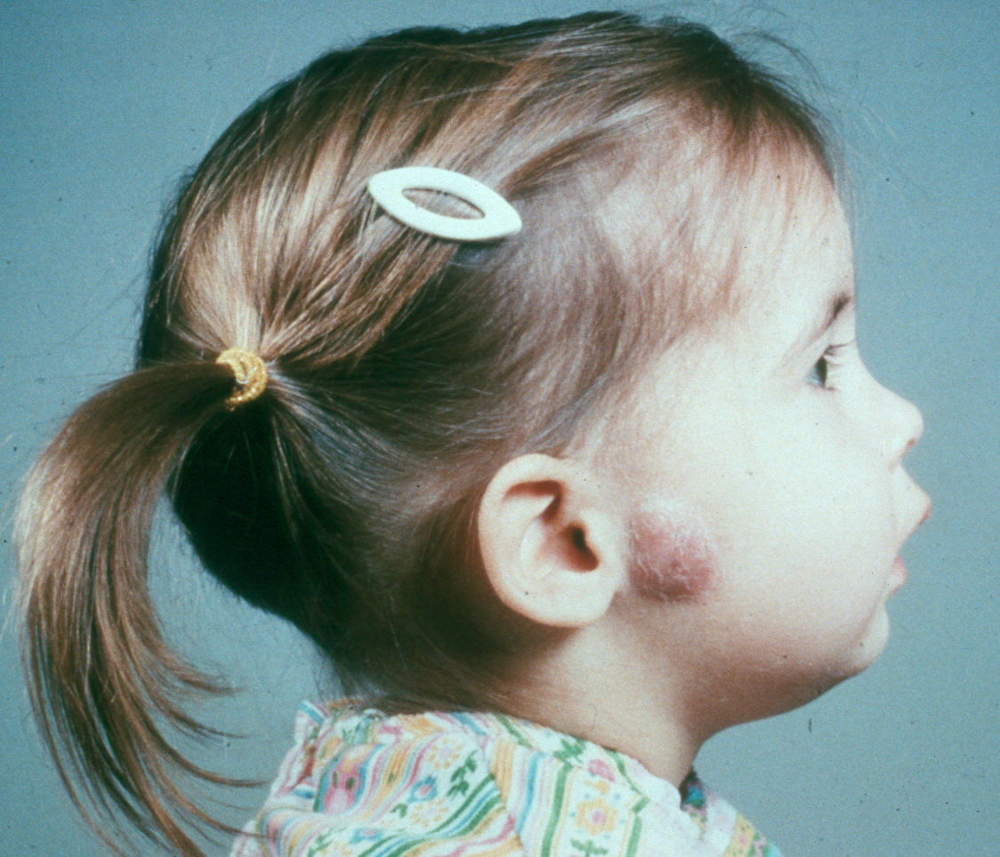

Slide 29
Lymphoma
More common in children and young adults
Up to 80% of children with Hodgkin’s have a neck mass
Signs and symptoms
  Lateral neck mass only (discrete, rubbery, nontender)
  Fever
  Hepatosplenomegaly
  Diffuse adenopathy

Slide 30
Lymphoma
FNAB – first line diagnostic test
If suggestive of lymphoma – open biopsy
Full workup – CT scans of chest, abdomen, head and neck; bone marrow biopsy

Slide 31
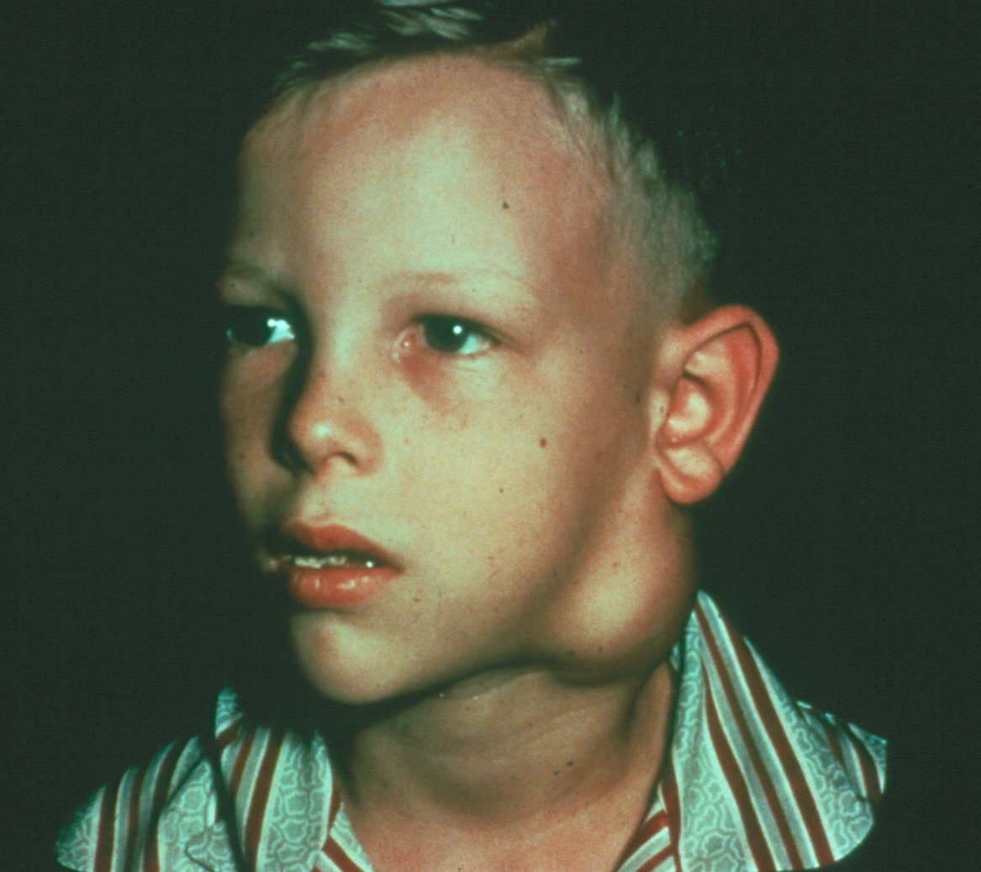

Slide 32
LUDWIG’S ANGINA
Diffuse cellulitis affecting submandibular triangle and floor of mouth.
Swelling and edema of floor of mouth, as well as bilateral brawny edema in tissue planes below jaw.
The tongue is displaced upwards with dribbling of saliva.
Fluctuation occurs late, and must never be waited for.
Edema may spread to involve larynx causing respiratory obstruction.
Treatment: Massive antibiotics, transverse incision behind chin, dividing deep fascia & mylohyoid muscle.

Slide 33
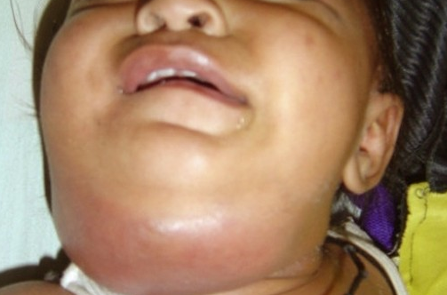
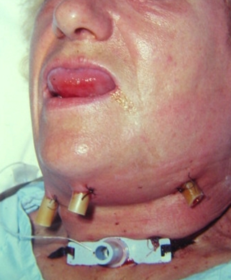

Slide 34
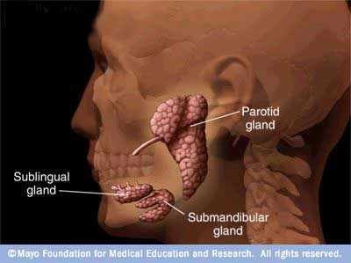
Salivary Glands
Parotid, submandibular and sublingual glands

Slide 35
Salivary Gland Tumors
Enlarging mass anterior/inferior to ear or at the mandibular angle
Benign
  Asymptomatic except for mass
Malignant
  Rapid growth, skin fixation, cranial nerve palsies

Slide 36
Salivary Gland Tumors
Diagnostic tests
  Open excisional biopsy (submandibulectomy or parotidectomy).
  FNAB:
    Shown to reduce surgery by 1/3 in some studies
    Delineates intra-glandular lymph node, localized sialadenitis or benign lymphoepithelial cysts
    Accuracy >90% (sensitivity: ~90%; specificity: ~80%)
  CT/MRI – deep lobe tumors, intra vs. extra-parotid

Slide 37
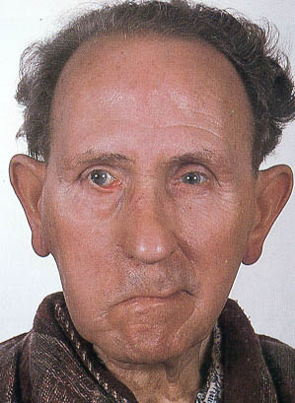

Slide 38
Adamantinoma (Ameloblastoma)
locally malignant tumor of paradental epithelial debris of Malessez.
lower jaw near the angle.
expanding jaw mainly outward causing thinning out of outer table.
grows forwards in the body and upwards in the ramus (horizontal & vertical rami).
Commonly affects females.
Slowly growing, painless swelling in lower jaw near angle.
It may give egg shell crackling sensation (thinned bone).

Slide 39
Plain X-ray shows multilocular cyst with fine honey - comb appearance with equal lobulation.
Resection of affected portion of mandible with a safety margin at least ½ inch followed later by replacement with an autogenous bone graft (rib graft) or dental prosthesis.

Slide 40
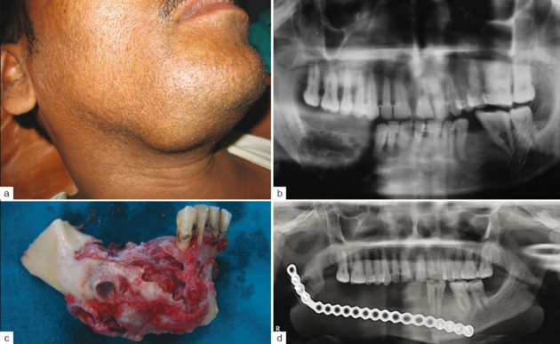

Slide 41
Carotid Body Tumor
Slow growing tumour of the carotid body at the carotid bifurcation. Eventually locally invasive.
Rare in children.
Pulsatile, compressible mass.
Mobile side to side not up and down.
Clinical diagnosis, confirmed by angiogram (lyre sign) or CT.
Treatment:
  Irradiation or close observation in the elderly.
  Surgical resection for small tumors in young patients.

Slide 42
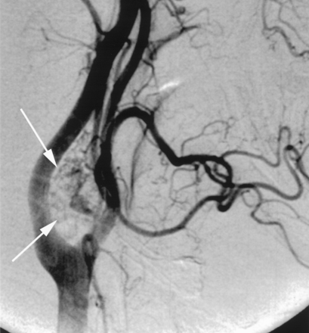

Slide 43
Lipoma
Usually >35 years of age
Soft, ill-defined mass, Slippery edge.
Asymptomatic.
Clinical diagnosis – confirmed by excision.

Slide 44
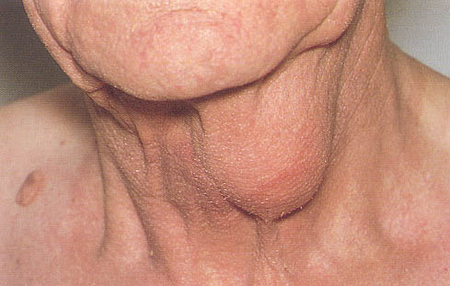

Slide 45
Sequestration dermoid Cyst
Congenital.
In the middle line anteriorly (sublingual, sub-mental, suprasternal) & posteriorly.
Contents: Cheesy keratinous material.
Clinical diagnosis: Painless, not tender, not fixed to deeper structures, not attached to skin unless infected.
Not translucent.
Does not move up & down with deglutition but in sublingual infra-myelohyoid dermoid becomes more prominent with deglutition.
Excisional biopsy confirms.

Slide 46
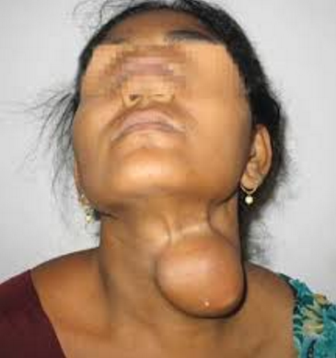

Slide 47
Sebaceous (Epidermid) cyst
Retention cyst of a sebaceous gland, due to obstruction of duct.
Not dating since birth.
Contents: Consist of semi-solid, greasy, sebaceous material with an unpleasant odour.
Duct: blocked and attached to the skin at one point, punctum looks as a black spot.
Well defined hemispherical tense cystic swelling with smooth surface.
Painless not tender, not fixed to deeper structures unless infected.
Not translucent.

Slide 48
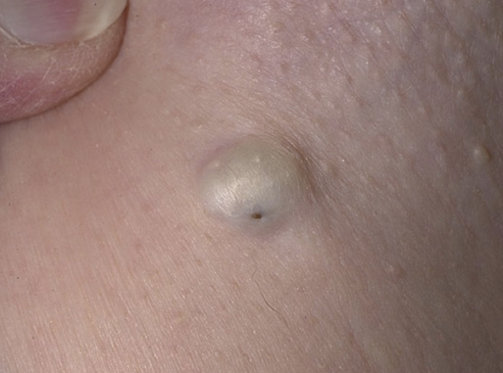

Slide 49
Neurogenic Tumors
Arise from neural crest derivatives
Include schwannoma, neurofibroma, and malignant peripheral nerve sheath tumor.
Increased incidence in NF syndromes.

Slide 50
Schwannoma
Sporadic cases mostly.
25 to 45% in neck when extra-cranial.
Most commonly between 20 and 50 years.
Usually mid-neck in poststyloid compartment.
Signs and symptoms
  Medial tonsillar displacement.
  Hoarseness (vagus nerve).
  Horner’s syndrome (sympathetic chain).

Slide 51
Branchial Cleft Cysts
Branchial cleft anomalies
2nd cleft most common (95%) – tract medial to CN XII between internal and external carotids.
1st cleft less common – possible close association with facial nerve.
3rd and 4th clefts rarely reported.
Present in older children or young adults often following URI.

Slide 52
Branchial Cleft Cysts
Most common as smooth, fluctuant mass underlying the SCM in front of its anterior border at the junction between the upper and middle two thirds.
fluctuant but doesn’t transilluminate, it doesn’t move on swallowing.
Skin erythema and tenderness if infected.
Treatment
  Initial control of infection
  Surgical excision, including tract
May necessitate a total parotidectomy (1st cleft).

Slide 53
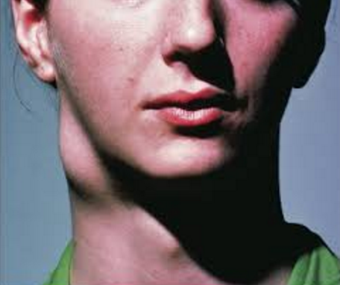
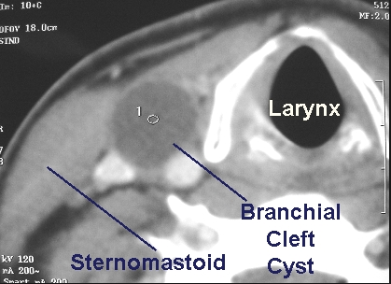

Slide 54
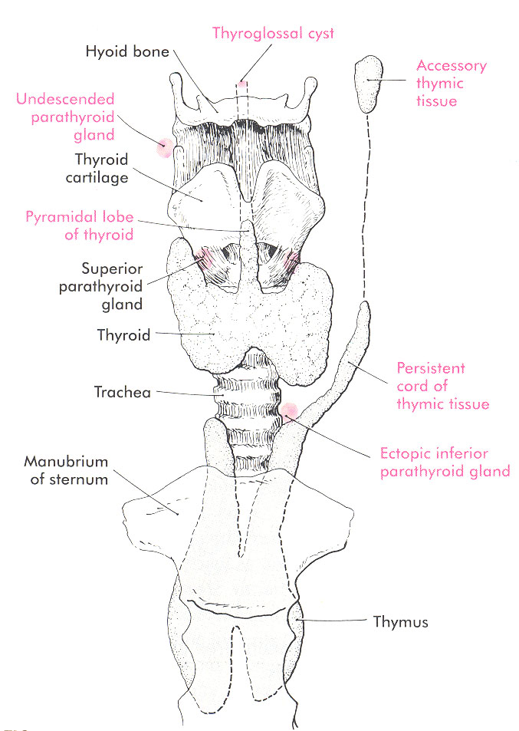
Thyroglossal Duct Cyst
Most common congenital midline mass.
Asymptomatic cystic mass at or below the hyoid bone moves up on swallowing and with tongue protrusion.
Symptomatic through inflammation.
Carcinoma: uncommon, 1%
  94% Thyroid- Papillary
  6% Squamous Cell

Slide 55
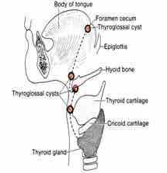
Thyroglossal Duct Cyst
1-2% have Ectopic Thyroid glands so imaging is indicated to document presence of a normal or ectopic thyroid gland.
Simple Excision leads to high recurrence rate.
Sistrunk Procedure.

Slide 56
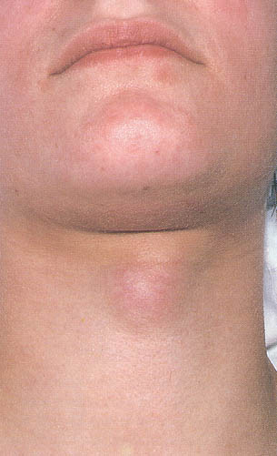
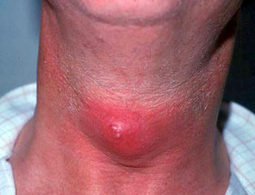

Slide 57
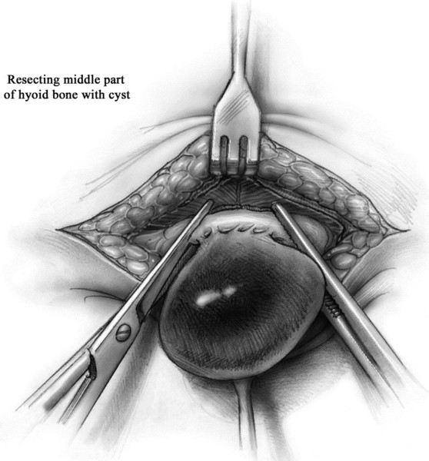
Moir. 2004⁸
Notes:
Sistrunk Procedure! If the mass is near the hyoid bone, use the sistrunk procedure to decrease recurrance.
4 Dissection continues directly onto the cyst where itis gently freed from surrounding tissue. The cyst may initially be located eccentrically but always narrows down to the midpoint of the hyoid bone. The lateral horns of the hyoid are identified as they fuse in the midline. The lateral musculature is freed just medial to the site of fusion on each site. The midpoint of the hyoid is grasped on either side of the suspected tracts with strong clamps. The bone is excised with Mayo scissors or light bone cutters.

Slide 58
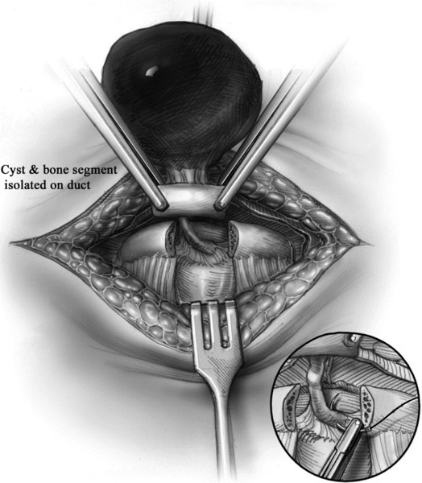
Moir. 2004⁸
Notes:
5 The mass is mobilized inferiorly along the suprathyroidfascia, leaving any suspected tracts with the midpoint of the bone. Once clear inferiorly,the anterior and superior muscles are gradually divided. As the last remnants ofmuscle are divided, care is taken to suture-ligate all possible accessory tractsleading to the base of the tongue. At this point, the anesthesiologist may help elevatethe foramen cecum further into the incision. The tract is then suture-ligated withabsorbable suture (inset). The muscles are re-approximated transversely in severallayers using interrupted stitches. The bone is not re-sutured. The remainder of thewound is closed in layers with absorbable suture. Generally no drains are placedunless there has been previous infection or a large amount of dissection has createdsignificant dead space.

Slide 59
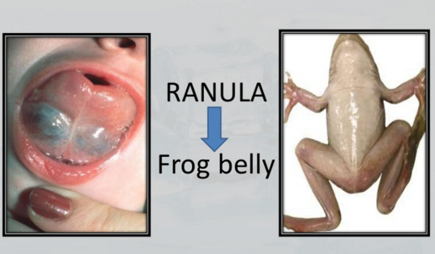

Slide 60
Plunging Ranula
Simple ranula- unilateral oral cavity cystic lesion.
Plunging ranula- pierce the mylohyoid to present as a paramedian or lateral neck mass.
Cyst aspirate- high protein, amylase levels.
CT scan/MRI.
Treatment is intraoral excision to include the sublingual gland of origin.
Marsupialisation (associated with a relatively high recurrence rate).

Slide 61
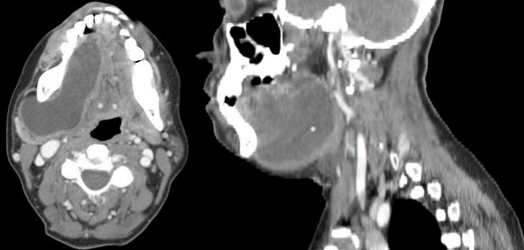

Slide 62
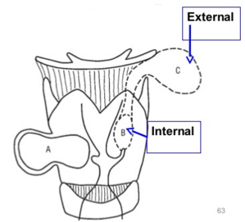
Laryngocele
Congenitally from an enlarged laryngeal saccule.
Classified as internal, external, or both.
Internal
  Confined to larynx, usually involves the false cord and aryepiglottic fold.
  Hoarseness and respiratory distress vs. neck mass.

Slide 63
Laryngocele
External and Combined Laryngoceles
  occupation requiring strain, chronic cough
  Soft, compressible, lateral neck mass that distends with increases in intra-laryngeal pressures.
  Resonant, translucent
  appears when patient blows his nose with the mouth closed.
  Through the thyrohyoid membrane at the entrance of the Superior Laryngeal Nerve.
  CT scan

Slide 64
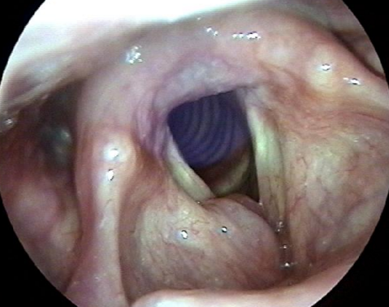
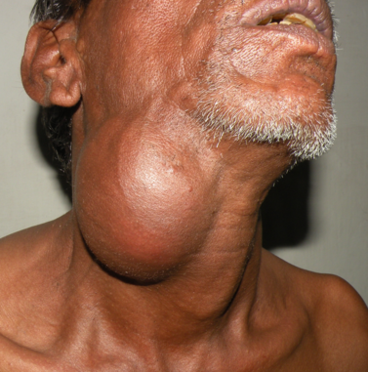

Slide 65
Laryngocele
Sac should be excised & the neck, which is crushed, ligated & divided, is invaginated like the stump of a vermiform appendix.
1-3% of Laryngoceles will harbor an underlying laryngeal carcinoma.
ALL adult patients should undergo direct laryngoscopy at the time of surgical intervention.

Slide 66
PNEUMATOCELE
It is herniation of the apex of the lung through supra-pleural membrane (Sibson's fascia).
Soft, compressible, supraclavicular, resonanat swelling
↑↑ in size on straining
Auscultation reveals breathing sounds
Treatment: Repair of the supra-pleural membrane after reduction

Slide 67
Sternomastoid Tumor of Infancy
(Psuedotumor)
An end-arterial branch of the superior thyroid artery supplies the middle part of the sternocleidomastoid; obliteration of this end artery may be responsible for the development of muscle fibrosis.
Firm mass of the SCM, chin turned away and head tilted toward the mass.
Ultrasound.
Physical therapy is very successful.
Myoplasty of the SCM only if refractory to PT.

Slide 68
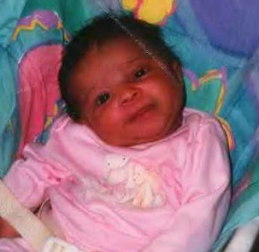
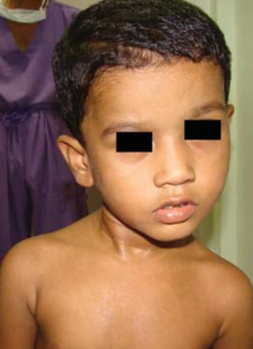
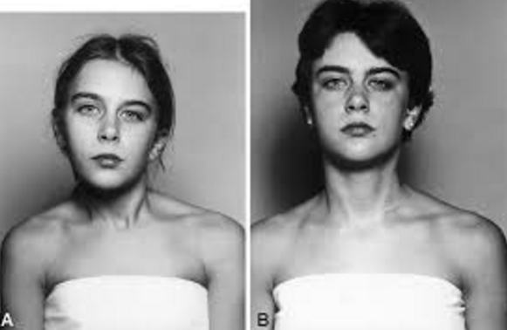

Slide 69
Vascular Tumors
Lymphangiomas and hemangiomas.
Usually within 1st year of life.
Hemangiomas often resolve spontaneously, while lymphangiomas remain unchanged.
CT/MRI may help define extent of disease.

Slide 70
Vascular Tumors
Treatment:
  Lymphangioma – surgical excision for easily accessible or lesions affecting vital functions; recurrence is common.
  Hemangiomas – surgical excision reserved for those with rapid growth involving vital structures or associated thrombocytopenia that fails medical therapy (steroids, interferon).

Slide 71
Lymphangioma Management - Controversial
Spontaneous resolution?
  Formation of new lymphatic channels?
Serial aspiration?
Sclerosant Agents?
  OK-432 (lyophilizied mixture of low-virulence group A Sterp pyogens
Surgical Excision?
  Is the surgical risk out weigh the benefit in a benign lesion
Burezq 2006¹⁴

Slide 72
Cystic Hygroma
Congenital lesion of lymph-filled spaces arising from an embryonic remnant of the jugular lymph sac.
Not a true cyst but rather a lymphatic hamartoma.
It consists of multiple intercommunicating cystic spaces like soap bubbles.
Cysts near surface are large while deeper ones are small and infiltrate muscles.

Slide 73
Soft, fluctuant and highly transilluminable lump just beneath the skin.
It may be lobular and usually is painless.
It contains clear fluid and may be of any size.
As well as being found on the neck and face they can be found on the chest wall or in the axilla.

Slide 74
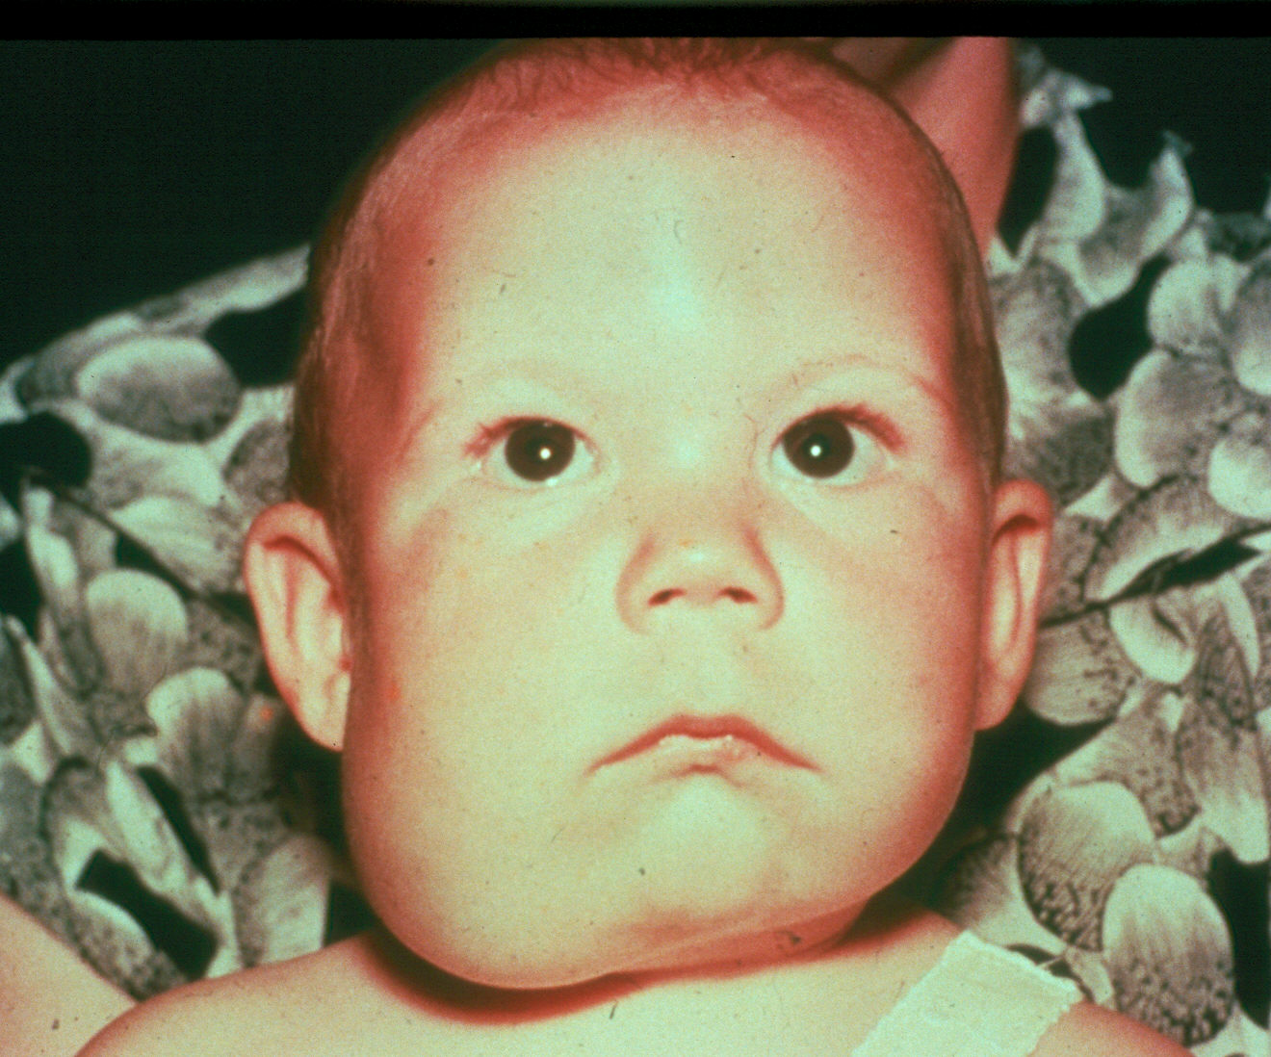

Slide 75
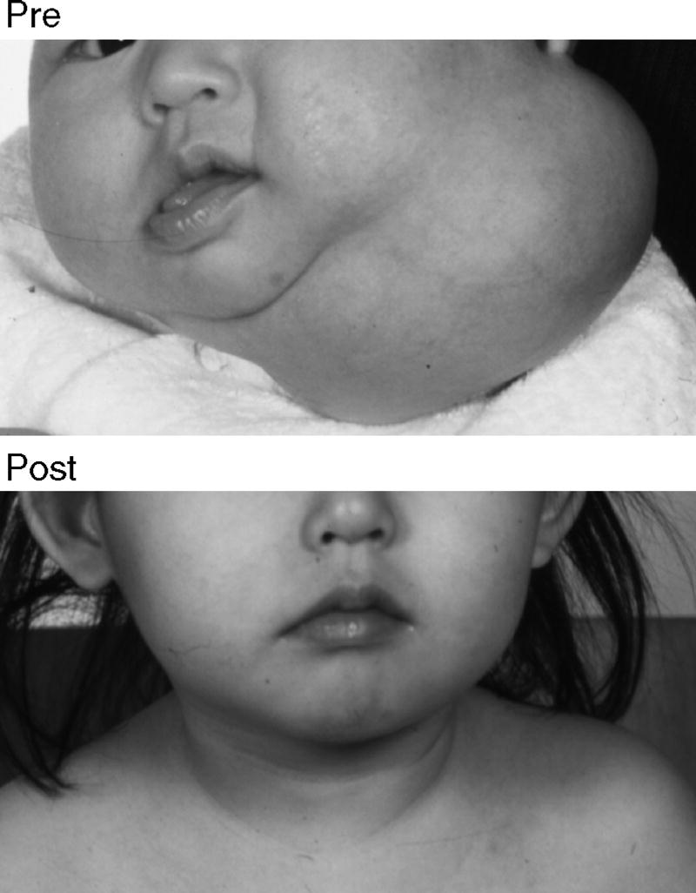
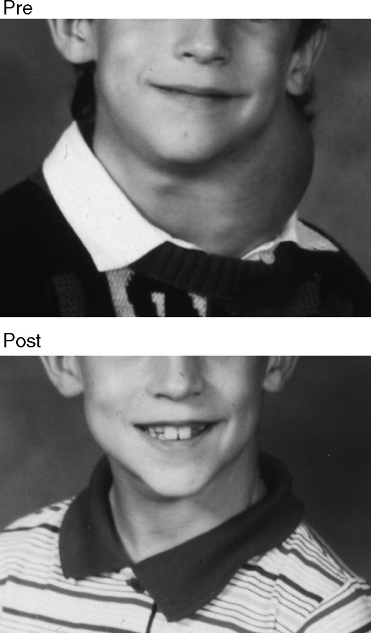
Success with Serial Aspirations
Burezq 2006¹⁴
Notes:
Fig 1 HV was a 4-week-old boy who presented with left large neck mass and dysphagia. Computed tomography scan showed a 4.8 × 3.6 cm multinucleated cyst extending into mediastinum as far down as level of carina and displacing trachea significantly to left and carotid sheath anteriorly. Internal jugular vein was minimally collapsed but patent. Aspiration was performed as therapeutic and diagnostic measure and revealed grossly bloody fluid. He needed a second aspiration at age of 11 years for mild recurrence. No further treatment was necessary.
Fig 2 PC was a 7-year-old boy. He had large left neck mass with positional stridor when lying flat. Ultrasound examination showed large cystic mass extending from left parotid area down to right clavicle. There was mild retrosternal extension with partial compression of right subclavian vein. Laryngoscopic examination revealed normal mobile vocal cords with adequate glottic inlet. There was large posterolateral supraglottic swelling pushing entire larynx to left. Aspiration was performed with complete resolution of cyst and relief of symptoms. The child did very well and was followed for 2 years with no recurrence.
From: Burezq: J Craniofac Surg, Volume 17(4).July 2006.815-818

Slide 76
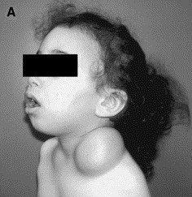
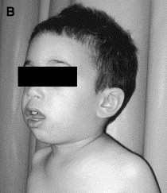
Success with OK-432
Gross et al, 2006¹⁶
Notes:
Supraclavicular macrocystic lymphangiomain a 3-year-old boy. (A) Before injection of OK-432. (B)The same patient 6 months after sclerotherapy with OK-432.

Slide 77
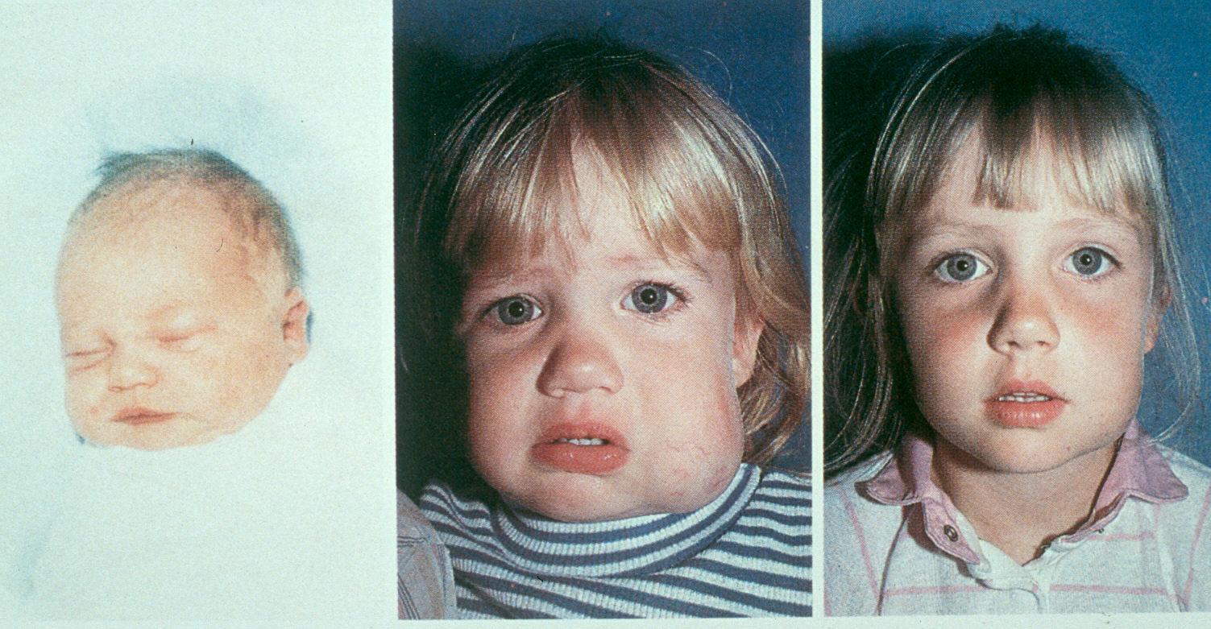

Slide 78
Pharyngeal Pouch (Zenker’s Diverticulum)
A diverticulum of the pharyngeal mucosa.
Bulges through a weakness in the pharyngeal constrictor (Killian dehiscence).
More common on the left rather than right, usually in elderly men.
Presents with long history of dysphagia, halitosis and a swelling in the neck that gurgles during swallowing.
Regurgitation of foul undigested food with attacks of choking & cough.
Diagnosed on barium swallow. Tea-pot appearance with fluid level.

Slide 80
General principles for diagnosis

Slide 81
Diagnostic Steps
History
  Developmental time course
  Associated symptoms (dysphagia, otalgia, voice)
  Personal habits (tobacco, alcohol)
  Previous irradiation or surgery
Physical Examination
  Complete head and neck exam (visualize & palpate)
  Emphasis on location, mobility and consistency

Slide 82
Empirical Antibiotics
Inflammatory mass suspected
Two week trial of antibiotics
Follow-up for further investigation

Slide 83
Diagnostic Tests
Ultrasonography
Computed tomography (CT)
Magnetic resonance imaging (MRI)
Radionucleotide scanning
Fine needle aspiration biopsy (FNAB)
Laboratory tests

Slide 84
Ultrasonography
An important tool
Solid versus cystic masses
Congenital cysts from solid nodes/tumors
Noninvasive

Slide 85
Computed Tomography
Distinguish cystic from solid
Extent of lesion
Vascularity (with contrast)
Detection of unknown primary (metastatic)
Pathologic node (lucent, >1.5cm, loss of shape)

Slide 86
Magnetic Resonance Imaging
Similar information as CT
Better for upper neck and skull base
Vascular delineation with infusion

Slide 87
Radionucleotide Scanning
Salivary and thyroid masses
Location – glandular versus extra-glandular
Functional information
FNAB now preferred for thyroid nodules
  Solitary nodules
  Multinodular goiter with new increasing nodule
  Hashimoto’s with new nodule

Slide 88
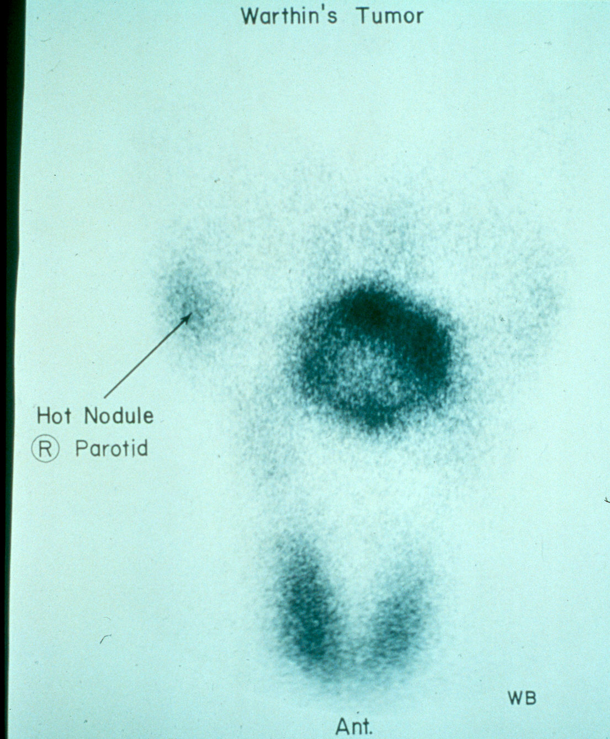

Slide 89
Fine Needle Aspiration Biopsy
Standard of diagnosis
Indications
  Any neck mass that is not an obvious abscess
  Persistence after a 2 week course of antibiotics
Small gauge needle
  Reduces bleeding
  Seeding of tumor – not a concern
No contraindications (vascular ?)

Slide 90
Fine Needle Aspiration Biopsy
Proper collection required
Minimum of 4 separate passes
Skilled cytopathologist essential
On-site review best

Slide 91
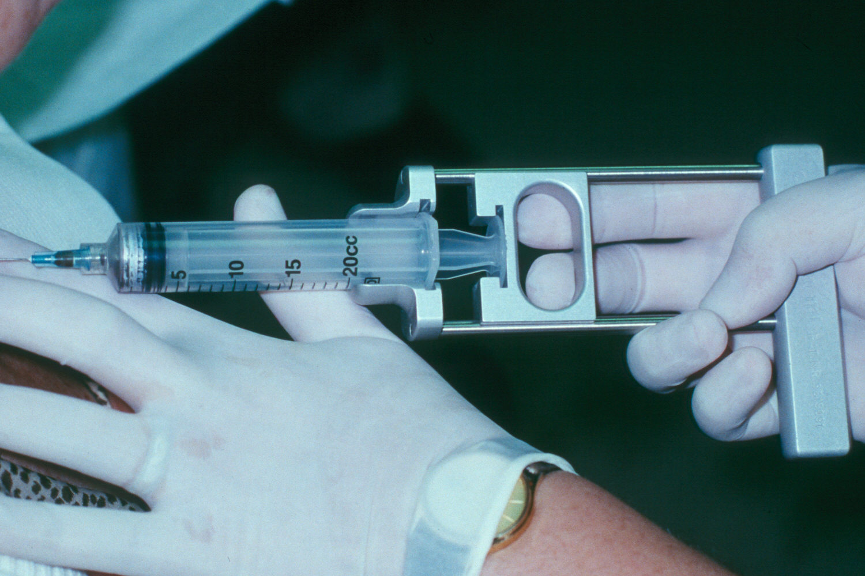

Slide 92
Laboratory test
Full CBC with differentiated count.
Thyroid profile: free T3 and T4 , ultrasensitive TSH.
LDH (suggestive for lymphoma)
Tumor markers: ??? Mets
Tuberculin test, ZN stain or TB culture from aspirate.
Cytopathological exam for FNAC.

Slide 93
Types of block neck dissection
Radical block neck dissection.
Modified radical block neck dissection.
Bilateral block neck dissection.
Selective block neck dissection.

Slide 94
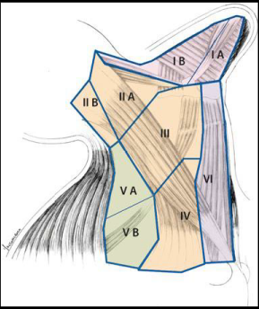

Slide 95
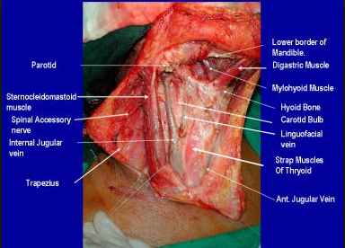

Slide 96
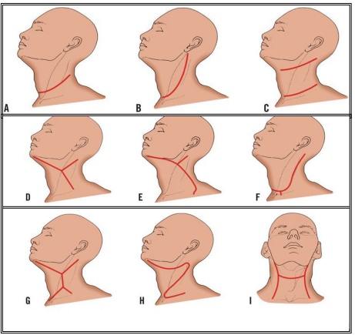

Slide 97
Radical block neck dissection
Lymph nodes of anterior and posterior triangles of neck.
Sternomastoid→ to expose internal jugular vein
Internal jugular vein → is removed from base of skull to its root in the neck
Spinal accessory nerve
Cervical fascia from jaw to clavicle
Submandibular salivary gland → easier removal of submandibular L.N.
Lower part of parotid salivary gland → contains lymph glands

Slide 98
Structures to be preserved:
1-Carotid arteries
2- Vagus
3- Sympathetic trunk
4- phrenic nerve
5- Hypoglossal nerve

Slide 99
Modified radical block neck dissection.
This refers to excision of all lymph node groups removed by the radical neck dissection with preservation of one or more of the following structures,
Type I: spinal accessory nerve.
Type II: spinal accessory nerve, and internal jugular vein.
Type III: spinal accessory nerve, and internal jugular vein and sternomastoid muscle (functional neck dissection).

Slide 100
Selective block neck dissection
Suprahyoid Block Dissection(level I-II)
Supraomohyoid neck dissection (level I-III)
Extended supraomohyoid dissection (level I-IV)
Lateral neck dissection (level II, III and IV)
Posterolateral neck dissection (level II-V)
The anterior compartment neck dissection (Level VI)
Superior mediastinum dissection (Level VII)

Slide 101

Thank you

